Slide 1
Mining Sales Data for Decision Making
August 2019

Slide 2
2
What we addressed…

Slide 3
3
Questions we helped the sales team answer:
Insights about customer purchasing behavior:
Do customers in different regions spend more per transaction? Which regions spend the most/least?
Are there differences in the age of customers between regions? If so, can we predict the age of a customer in a region based on other demographic data?
Is there any correlation between age of a customer and if the transaction was made online or in the store? Or do other factors correlate to an online or in-store transaction?
Is there a relationship between the number of items purchased and amount spent?

Slide 4
4
Questions we helped the sales team answer:
New products should we offer:
Given sales’ shortlist of 17 new products, what are the top 5 we should offer?
What is the predicted profitability of these shortlisted products?

Slide 5
5
How we did it…

Slide 6
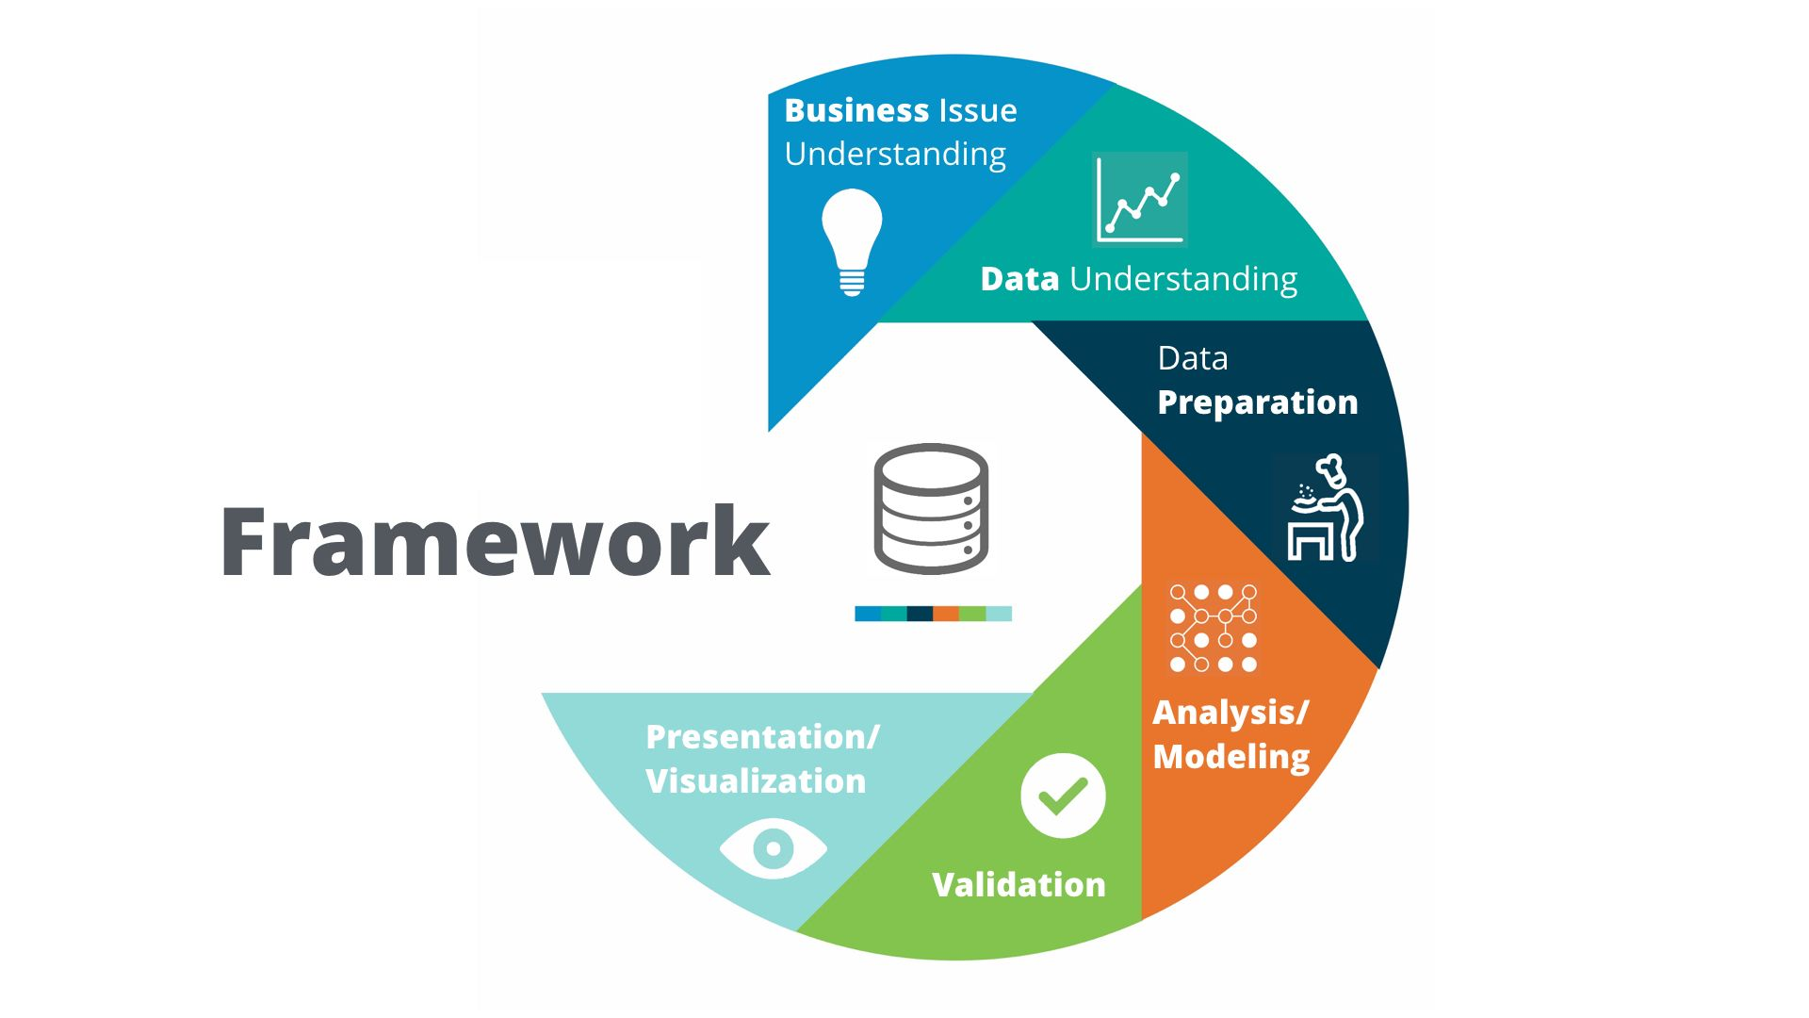

CRISP - DM (Cross-industry standard process for data mining)
6
RapidMiner Named a Leader in Gartner’s 2019 Magic Quadrant for Data Science and Machine Learning Platforms for Sixth Consecutive Year.
“Gartner Magic Quadrant for Data Science and Machine-Learning Platforms,” by Carlie Iodine, Peter Krensky, et al., January 28, 2019.
https://www.kaggle.com/ananta/solving-data-science-problems-using-crisp-dm

Slide 7
7
What we discovered…

Slide 8
8
Results –Customer Buying Patterns
Decision Tree Model – Online vs In-store
84.5% confident in model results
If current trends continue
Amount Spent in Transaction is Key
More than $1,998.90 = Online
Less than $1,998.90
Age - older than 74.5 (Online)
Next, Region determines behavior
West – all online purchases
Central – age group
East – dollar amount
South – dollar amount then age

Slide 9
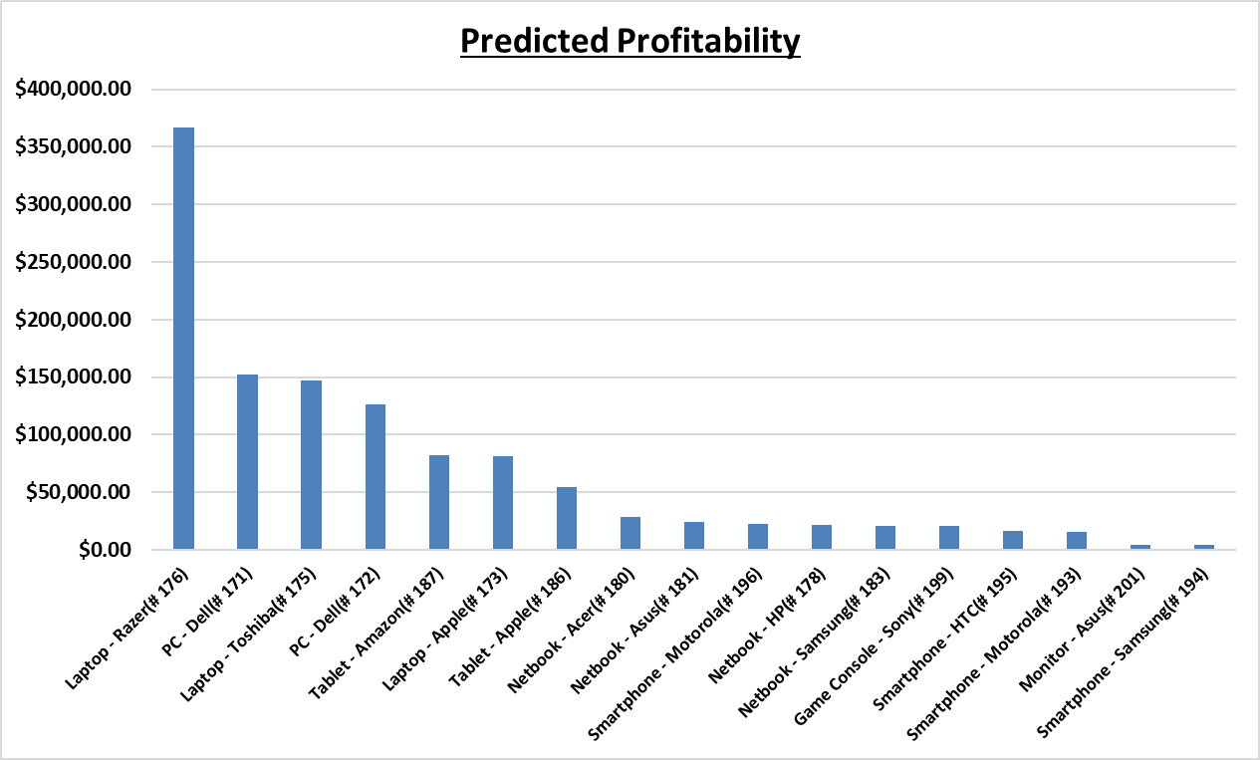
9
Results – New Product Profitability
Top 5 Potential Products | Predicted Profitability
Laptop – Razer (# 176) | $366,728.07
PC – Dell (# 171) | $152,218.15
Laptop – Toshiba (# 175) | $147,405.58
PC – Dell (# 172) | $126,428.12
Tablet – Amazon (# 187) | $82,053.32

Slide 10
10
Other questions data mining can help answer…

Slide 11
11
Other ways data mining can help to improve our business
Leverage a combined demographics and product sales data set to investigate how well certain products sell to certain demographics
Combining what we learned with our initial data analysis on demographics to build a business plan to increase sales
Area of interest: Product Recommendations
Possible with use of data mining
Gives us better potential to cross-selling

Slide 12
12
Thank you!

Slide 13
13
Appendix

Slide 14
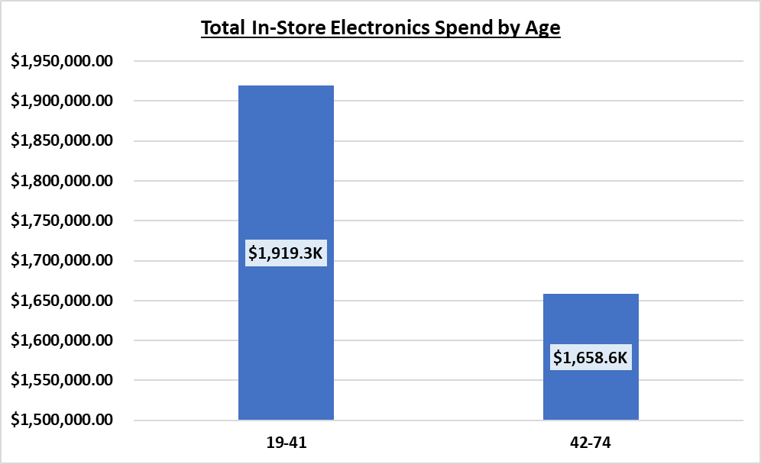
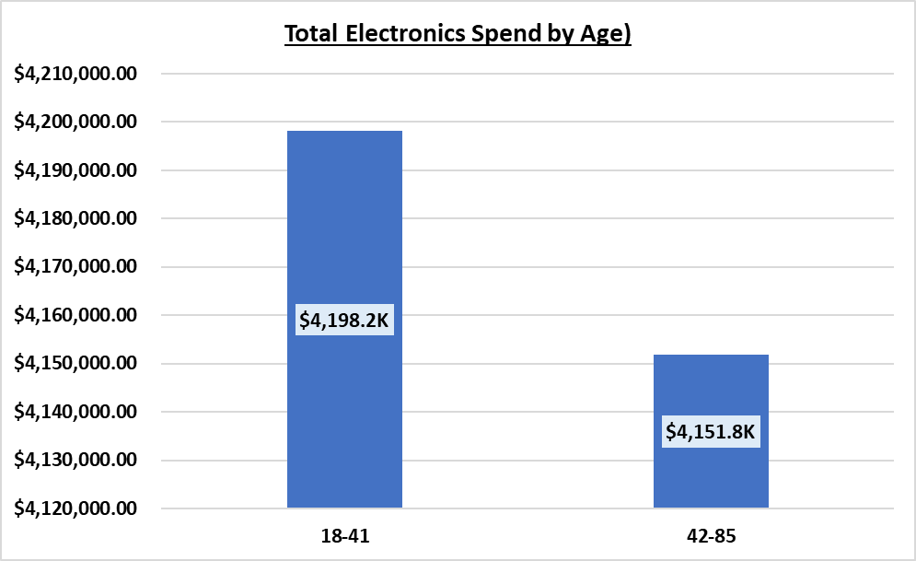
Age & Purchase Location Assumptions
Older Customers Shop More In-Store & Spend More on Electronics than Younger Customers
19 - 41 = 53.6% of In-Store Sales
AVG Spend Per Transaction
19 – 41 = $865.32
42-74 = $709.73
18 – 41 = 50.3% of Electronic Spend
AVG Spend Per Transaction
18 – 41 = $981.57
42 – 85 = $725.47

Slide 15
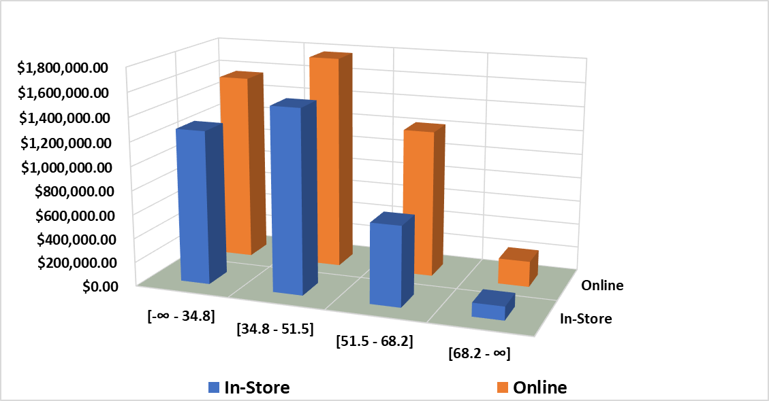
Age & Purchase Location Assumptions
Older Customers Spend More In-Store
Even with 4 age tiers each one spend more online than in-store.

Slide 16
More Items = More Sales Per Purchase?
Item QTY | Sales | # of Purchases | Average Price Per Purchase
1 | $581,770.34 | 694 | $838.29
2 | $1,207,261.33 | 1,441 | $837.79
3 | $1,221,609.62 | 1,462 | $835.57
4 | $1,218,876.37 | 1,453 | $838.87
5 | $1,100,774.51 | 1,318 | $835.19
6 | $1,232,395.36 | 1,494 | $824.90
7 | $1,154,872.45 | 1,393 | $829.05
8 | $632,441.83 | 745 | $848.92
All item tiers end up in the same AVG Spend $820-$850 per transaction. No real correlation of items to sales

Slide 17
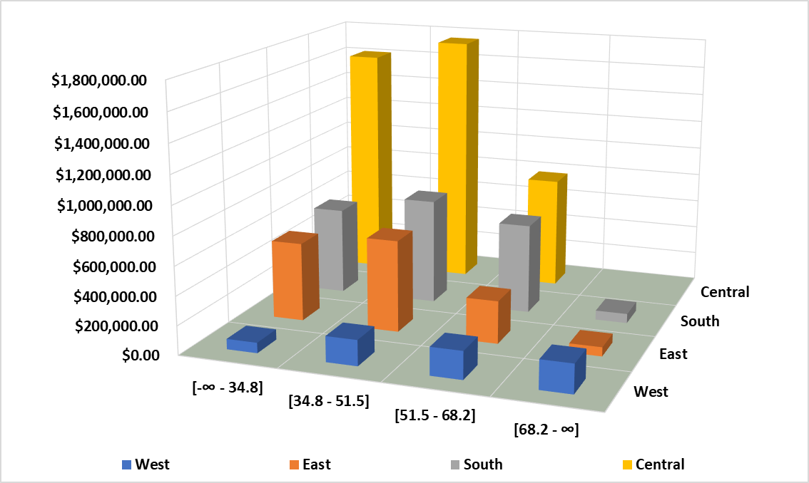
Age by Region - Sales

